Slide 1









Logout
Reset
€0.00
Insert Money
Check Change
Pay

Slide 2




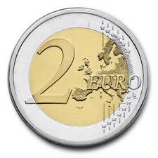
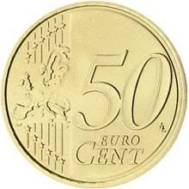

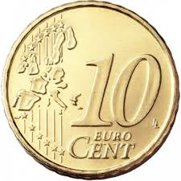
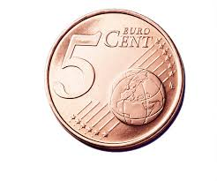




Logout
Logout
€50.00
X 2
- +
X 3
- +
X 2
- +
X 4
- +
- +
+
Total: 00.00

Slide 3
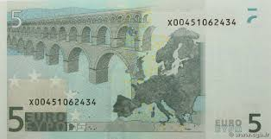
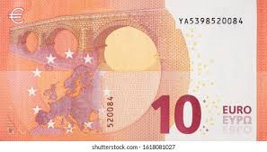

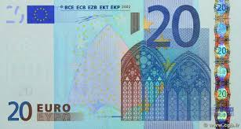

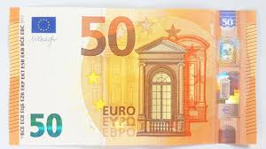


Logout
Logout
X 2
- +
X 2
- +
X 3
- +
X 3
- +
X 2
- +
X 2
- +
Clear Amount/Reset
- +
X 4
- +
X 4
Add Money?
Yes
No
Yes
- +
- +
No
Total: 00.00
Total: 00.00

Slide 4


Logout
Logout
€50.00
Add Money?
Yes
No
+
+
€27.80

Slide 5
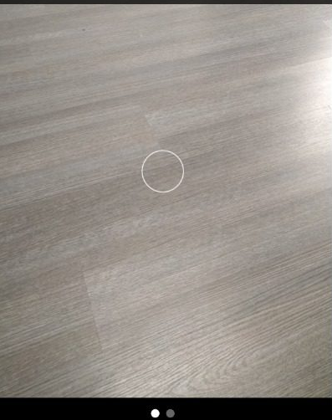
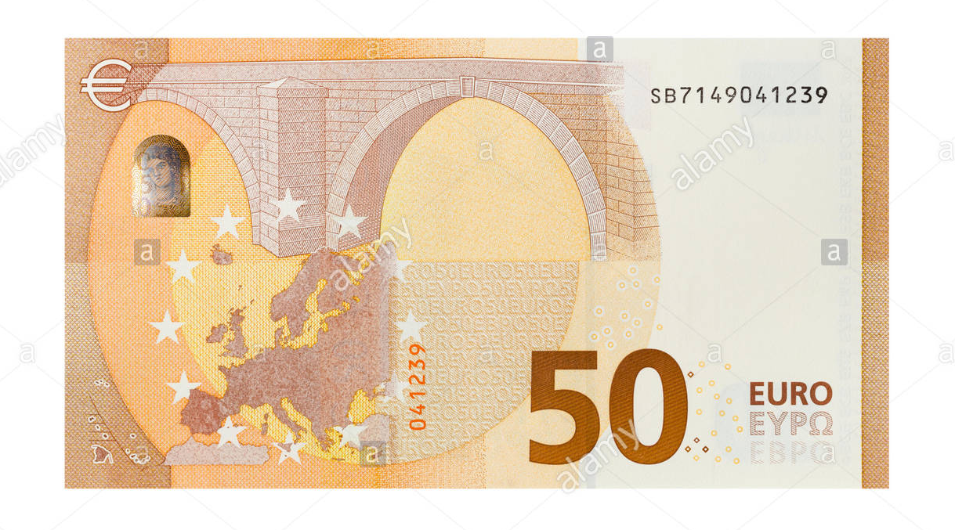
Logout
Logout
€0.00
€50.00
x1
+
Scan
Scan

Slide 6
Logout
€50.00
Add Money?
Yes
No
x1
+
Scan

Slide 7

Logout
Logout
€0.00
Reset
€50.00
Failed to Scan
Retry?
Count Money
Check Change
Pay
Scan

Slide 8
Logout
Logout
€50.00
Reset
€50.00
Count Money
Check Change
Pay
€27.80

Slide 9

Logout
€50.00
Did not Recognize
Dot Appears when recording
Retry?
Enter Price
Confirm
€27.80
Display Price
Submit Price Paid

Slide 10
Logout
Logout
€22.20
Reset
Amount Paid Subtracted From Wallet
€22.20
Add up Change when Scanned
+
Click Check Change
Add
Count Money
Check Change
Pay
Check
Scan

Slide 11

Logout
Logout
€22.20
€22.20
Error Message
Failed to Scan
Correct Change
Retry?
Check if Change is Correct
Check
Scan
Check
Scan

Slide 12

Logout
Logout
€22.20
Reset
€22.20
Incorrect Change
Count Money
Check Change
Pay
Check
Scan

Slide 13


Reset Confirmation
Logout
Logout
Reset
Reset?
Reset
Money Reset
€22.20
€00.00
Count Money
Check Change
Count Money
Check Change
Pay
Pay

